Slide 1

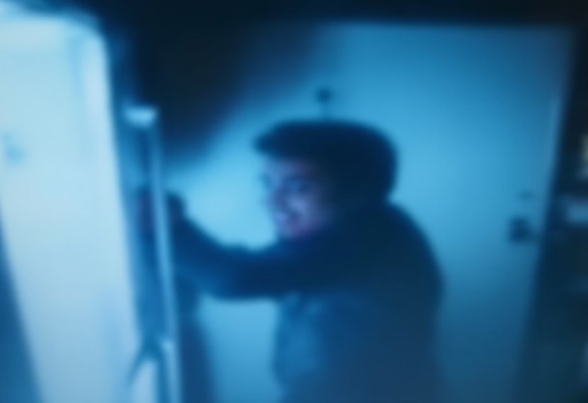
Case: The Ice-Cream Theft!!
In a house with 6 roommates, someone has been secretly raiding the freezer at night.
Our only evidence? Grainy, dark footage from a fridge camera. The culprit remains unidentified.
Our solution: Deploy a Convolutional Autoencoder to clean up the blurry images. This deep learning technique reconstructs clearer facial features.
By training our neural network on similar images,
we can reveal who's been stealing the ice cream all along.
by Guardians Of the Galaxy

Slide 2
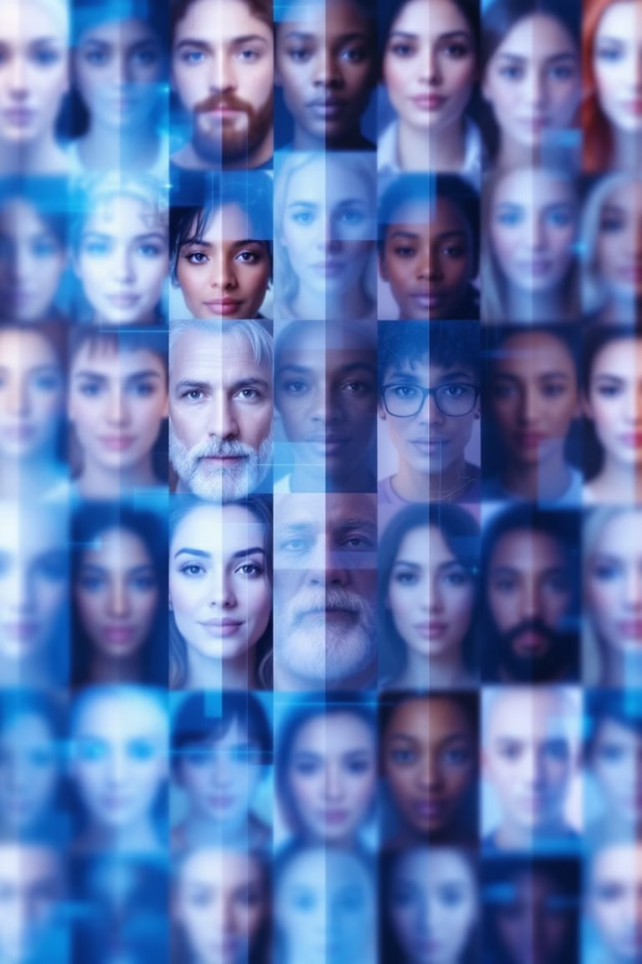
Creating the Roommate Dataset
We leveraged the Labeled Faces in the Wild (LFW) dataset, selecting 6 individuals with 30+ face images each.
All images were standardized to 64x64 pixels to represent our potential ice cream thieves.
Small dataset increases risk of overfitting
Poor generalization becomes likely with limited training samples
Noisy, low-light images compound these challenges for our CAE model

Slide 3
Dataset Preprocessing Across Team Members
We explored different preprocessing strategies to test our CAE models' robustness. Each approach balanced noise and augmentations differently.
Member
Augmentations Used
Noise Factor
Test Transform
Notes
Prince
None
0.3
Resize + ToTensor
Clean input; high noise for harder learning
Debjani
Horizontal Flip, Rotation, Color Jitter
0.15
Resize + ToTensor
Balanced: realistic augmentations + mild noise
Kathryn
Crop, Flip, Rotation, Color Jitter, Affine, Grayscale
0.15
Resize + ToTensor
Strong augmentations for generalization
These preprocessing choices significantly impact how well our models handle variations in the nighttime fridge camera footage.

Slide 4
Why We Use a Convolutional Autoencoder (CAE)
Structure & Benefits
Advantages Over Basic DAE
Perfect for Our Case
CAEs compress and reconstruct images while preserving critical features.
Convolutions make CAEs ideal for our night-vision footage problem.
CAEs isolate facial features from noisy "thief cam" footage.
Preserves spatial structure in faces
This helps reconstruct clean images to identify our ice cream bandit.
Uses convolution + pooling to compress images into a lower-dimensional latent space.
More parameter-efficient with small datasets
Excels at recognizing patterns in noisy data
Decoder reconstructs original from compressed form
Sigmoid activation keeps pixel values normalized

Slide 5
Comparing CAE Architectures Across Team Members
Member
Model Type
Latent Size
Activation
Normalization
Dropout
Prince
Classic CAE
128
ReLU
None
None
Debjani
Improved CAE
256
LeakyReLU
BatchNorm2d
0.1–0.3
Kathryn
Improved CAE
128
LeakyReLU
BatchNorm2d
0.0–0.4
All models employ convolution layers for encoding/decoding with flattened latent vectors for compression.
Sigmoid output activation ensures proper pixel value scaling across all architectures.
These variations help evaluate how architecture complexity impacts reconstruction quality in noisy nighttime footage.

Slide 6
Hyperparameter Sweeps & Tuning Strategies
We leveraged Weights & Biases Sweeps to discover optimal configurations. Each team member executed personalized sweeps with unique search approaches.
Member
Search Method
Latent Vector
Learning Rates
Noise Levels
Batch Sizes
Prince
Random
64-128
1e-3, 1e-4
0.1-0.3
32, 64
Debjani
Random
96-288
1e-2, 5e-4, 1e-4
0.1-0.2
16, 32
Kathryn
Bayesian
64-256
1e-3, 5e-4, 1e-4
0.05-0.2
16-64
All sweeps ran for 40 epochs, optimizing for validation MSE. Prince established a baseline, Debjani explored larger latent spaces, while Kathryn employed Bayesian search for efficiency.

Slide 7
Top Performing Models – Sweep Results
After extensive hyperparameter sweeps, we identified each team member's best configuration based on test MSE performance.
Member
Run Name
Latent Dim
Learning Rate
Dropout
Noise
Test MSE
Test MAE
R² Score
Prince
CAE_crrux15s
128
0.001
None
0.3
0.02432
0.1116
0.608
Debjani
ImprovedCAE_whhootdi
288
0.0005
0.1
0.1
0.01878
0.10314
0.690
Kathryn
ImprovedCAE_zufl6ccx
128
0.0005
0.1
0.2
0.0173
0.09690
0.695
Kathryn's Model Superiority
Learning Rate Impact
Noise-Dropout Balance
Her configuration achieved lowest error metrics and highest R² score, despite using moderate latent dimensions.
Moderate learning rates (0.0005) consistently outperformed more aggressive approaches in final test metrics.
Optimal results came from configurations that carefully balanced noise injection without excessive dropout regularization.

Slide 8
Final Experiment – Higher Resolution & Larger Dataset
Previous experiments showed performance plateaus despite architectural improvements. We needed to break through this ceiling.
Resolution Limitation
Data Scarcity
64x64 images lacked sufficient facial detail for accurate reconstruction.
Only 30 images per person restricted the model's ability to generalize.
Enhanced Protocol
Higher Fidelity
VGGFace2 subset with 400 images per identity across 6 subjects.
128x128 resolution captures finer facial features even with noise factor of 0.4.
This final configuration aimed to determine if more data and higher resolution would improve denoising performance and generalization capability.

Slide 9
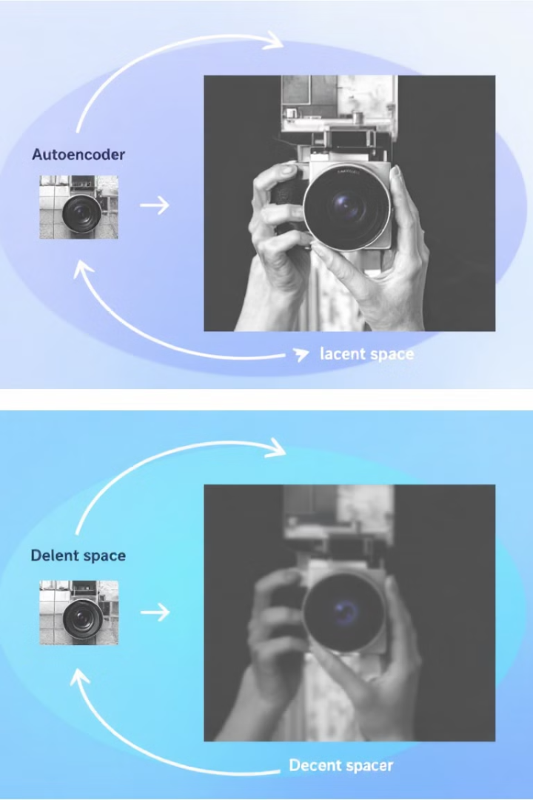



Final CAE Architecture for 128x128 Images
Our Improved Convolutional Autoencoder handles higher-resolution inputs with a deeper structure optimized for facial reconstruction.
Encoder
Four convolutional blocks compress 128×128 RGB images through progressive downsampling to 8×8 feature maps.
Conv2D → BatchNorm → LeakyReLU → MaxPool2D → Dropout
Output resolution flows: 128x128 → 64x64 → 32x32 → 16x16 → 8x8
Latent Space
Compact vector (128-384 dimensions) captures essential facial features with minimal information loss.
Decoder
Four transposed convolutional layers reconstruct original resolution with sigmoid activation ensuring proper scaling.

Slide 10
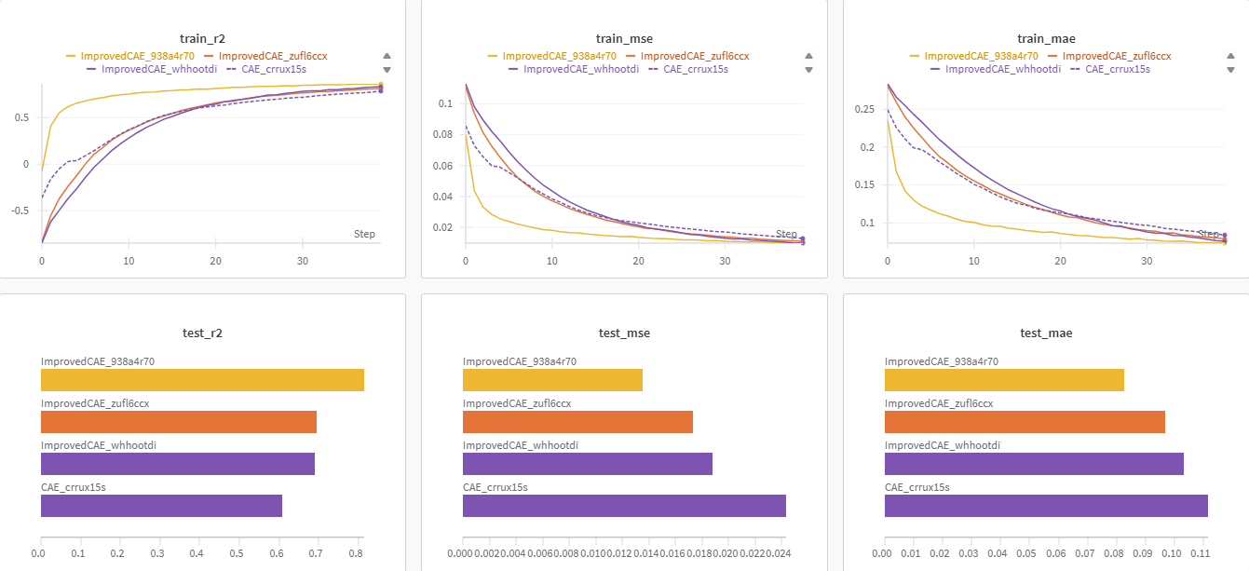
Evaluation Charts

Slide 11
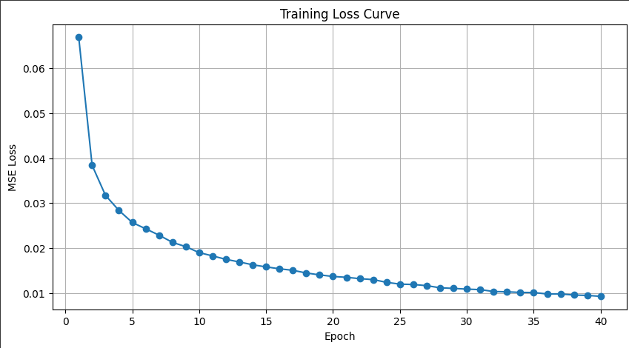
Loss Curve – Convergence

Slide 12
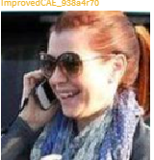
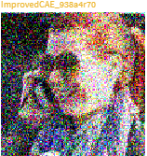
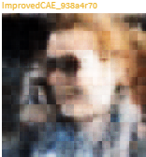
Reconstruction Of Images
Clean Sample
Noisy input
Reconstructed Output

Slide 13

I Spy The Ice Cream Guy
Our mission is complete — with the power of Convolutional Autoencoders, we were able to de-noise blurry thief cam footage and reveal relatively clearer faces.
Smarter architectures ✅
Better data ✅
Higher resolution images ✅
Noise-hardened training ✅
We've now got a system that can spot the ice cream thief in action — even in the dark!
We've got our 'Ice' on you!

